Slide 1
Tasks & Competencies
Business Intelligence & Analytics

Slide 2
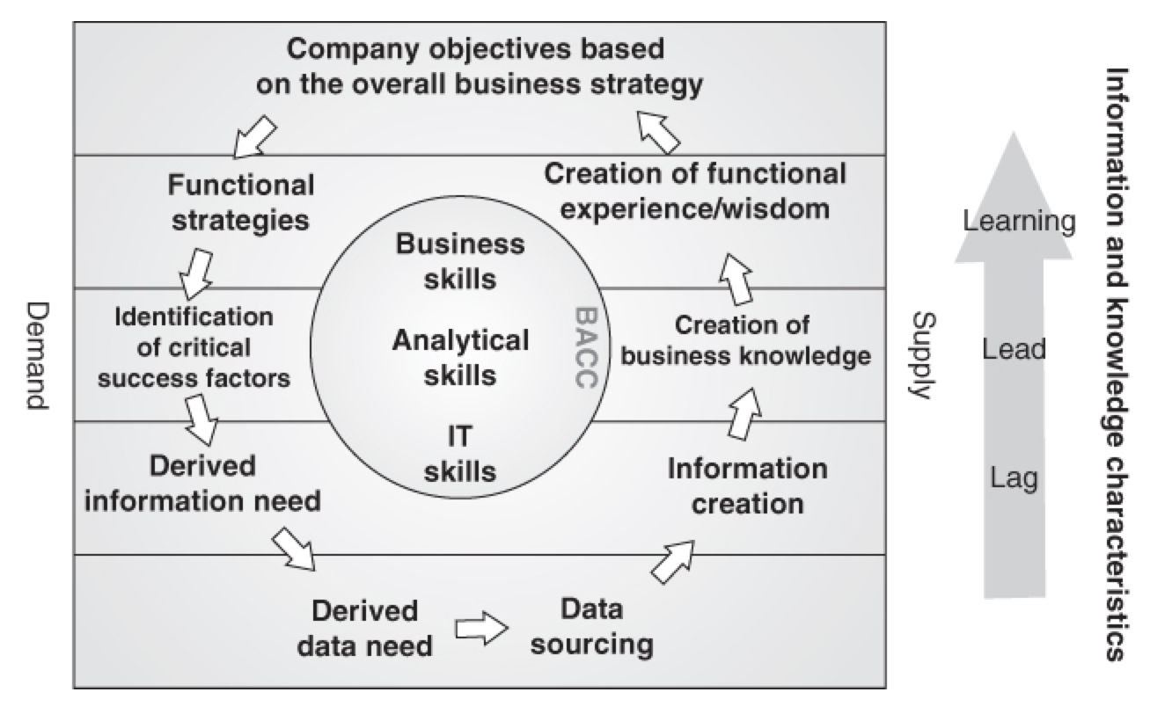
The information wheel
Notes
The Information Wheel describes the process of providing analytics to the business
Note that it is not always a cycle as shown, many projects finish with no follow up
Shows that the BACC lies at the center of what is provided
The BACC can be a dedicated team or can be decentralized (more on this later)

Slide 3
Creating Learning
Notes
The purpose of knowledge management is to have the best of both: a decentralized organization releasing its full creative potential while at the same time making sure that other decentralized units reuse the good ideas generated.
How do we do it?
Public document store
Internal Wiki
Knowledge Management System
Digital solutions may lead to person-to-person interactions (and improve the knowledge stored in digital form)

Slide 4
Marketing
Product Dev
Sales
Customer List
Customer List
Customer List

Slide 5
BACC
Marketing
Product Dev
Sales
Customer List
(may still have 3 definitions)
(but will be fully aware)
Notes:
In this case, we have increased coordination, but have not changed the business processes.

Slide 6
Technology implications
Marketing
Product Dev
Sales
Marketing
Data Warehouse
Product
Data Warehouse
Sales
Data Warehouse

Slide 7
Technology implications
Marketing
Product Dev
Sales
Business
Data Warehouse

Slide 8
Technology benefits
Could reduce software costs via standardization and reduced duplication
A possible better negotiating position with vendors
Reduced number of technologies results in smaller need for expertise in different software packages
Reduces the number of projects needed to integrate different platforms
Notes:
Reduced number of technologies = actually opens up the labor market for you

Slide 9
Additional notes about technology
The BACC does not design information architecture or technology strategies
The BACC enters into a dialogue with system owners to ensure the information architecture and technology strategies support the organization’s information strategy
The scope of the BA function should be dictated by the business, not by technological solutions

Slide 10
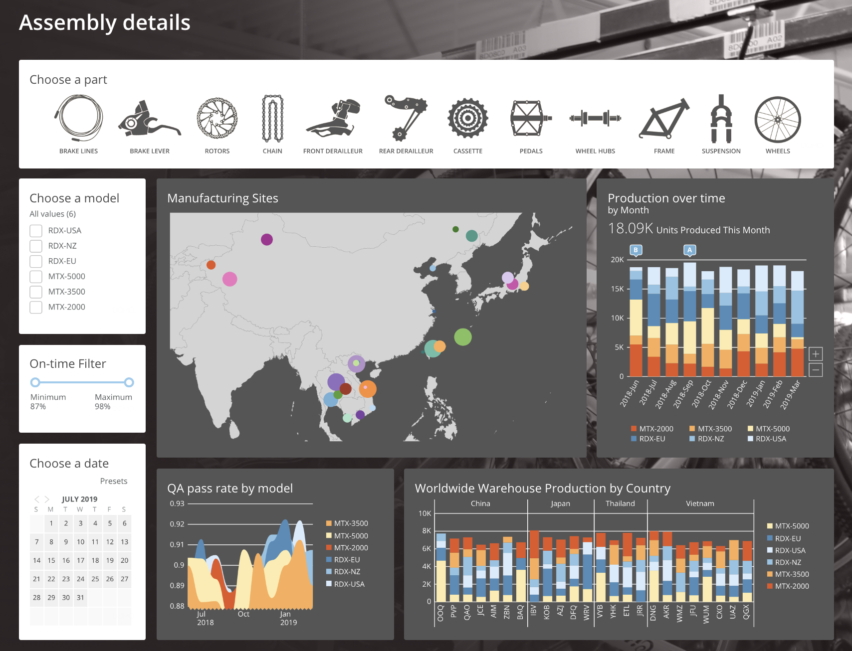
Educating users
The results of the information generation process will create some solution (often a report or dashboard).
The following are true:
The solution is never better than its users
A successful implementation requires three elements
User friendliness
Relevant information
General support

Slide 11
Educating Users
User Friendliness
What
The system/report must be inviting, intuitive, and clear
How
Get feedback from users
Typically needed before and after delivery
Build in a period for feedback
Relevance of Information
What
Information must be available, accurate, and actionable
How
Requires a front-end system that can provide information at the speed necessary
Need to validate data both internally and externally
Right data to the right people at the right time in a way they can use it
General Support
What
Users should be trained, there should be a way to get answers to questions and submit feedback
How
Training sessions
Remote training sessions
Video content that can be referred to when needed (knowledge management system)

Slide 12
Prioritization
One task of the BACC is to prioritize new BA initiatives: will cover this in chapter 8

Slide 13
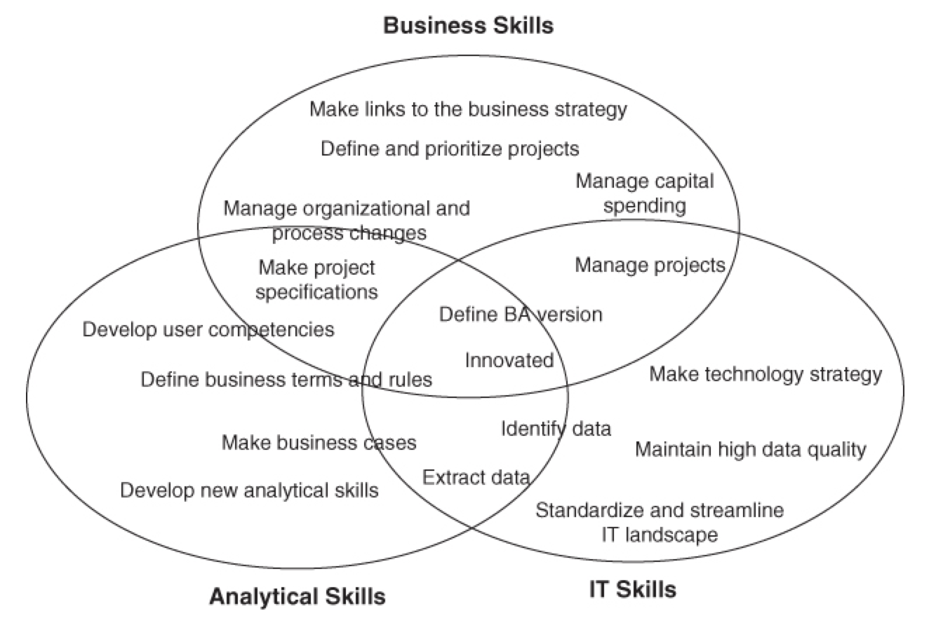
BACC Competencies
Notes:
Difference between the competencies needed for the BACC and the organizational structure. Will discuss this in the next section.

Slide 14
Discussed tasks and competencies of the Business Analytics Competency Center
Benefits in information strategy and technology strategy

Slide 15


